Slide 1




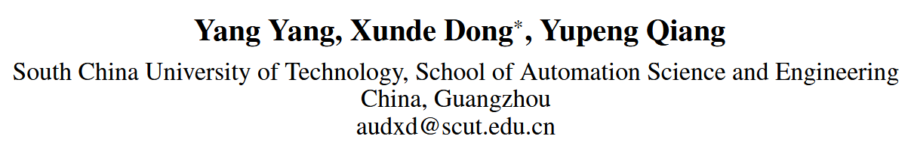





ATAI
Advanced Technique of Artificial Intelligence
ATAI
ChongqingUniversity _{AdvancedTechniqueof}
of Technology Artificial Intelligence
Chongqing University of Technology
Chongqing University ^{ATAI}
_{of Technology} Advanced Techniqueof
Artificial Intelligence
Chongqing University of Technology
Chongqing University of Technology
MSE-Adapter: A Lightweight Plugin Endowing LLMs with the Capability to Perform Multimodal Sentiment Analysis and Emotion Recognition
code:https://github.com/AZYoung233/MSE-Adapter
—— AAAI ’25
Reported by Shu Ming Jiang
1

Slide 2
ATAI
Advanced Technique of
Artificial Intelligence
ATAI
ChongqingUniversity _{AdvancedTechniqueof}
of Technology Artificial Intelligence
Chongqing University of Technology
Motivation
1) Once trained for MSA and ERC tasks, these pre-trained language models lose their original generalized capabilities.
2) They demand considerable computational resources.

Slide 3
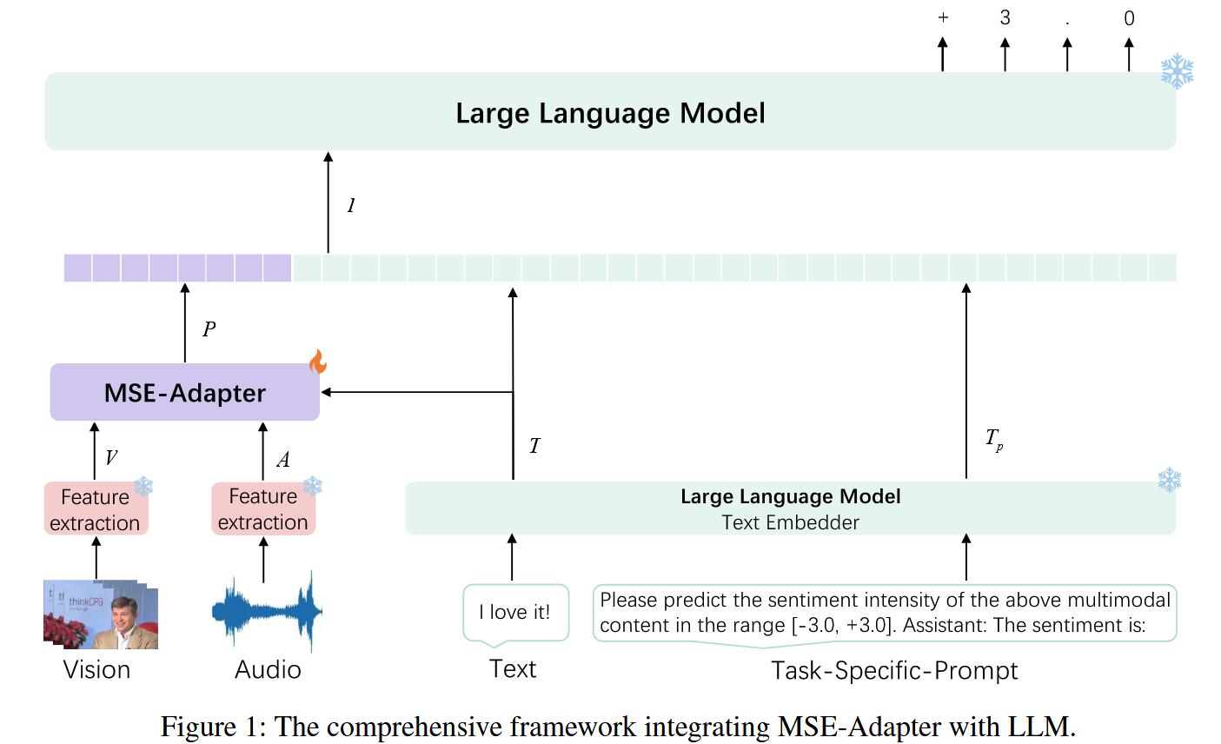
ATAI
Advanced Technique of
Artificial Intelligence
ATAI
ChongqingUniversity _{AdvancedTechniqueof}
of Technology Artificial Intelligence
Chongqing University of Technology
Overview

Slide 4
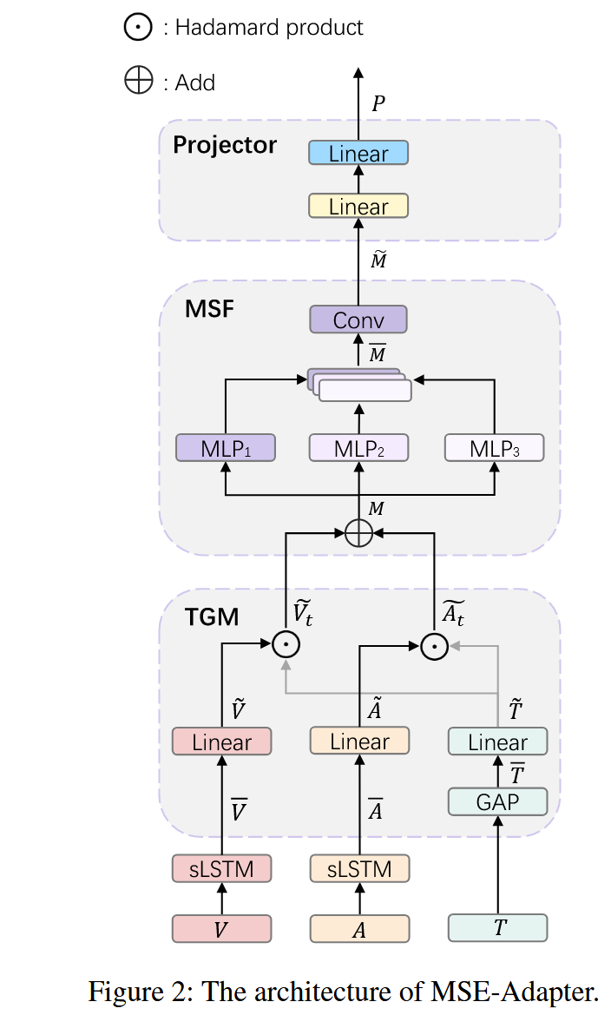

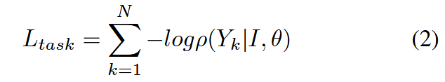
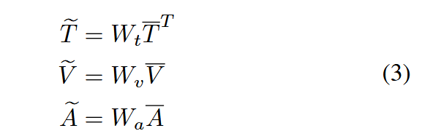
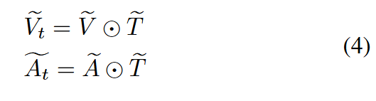


ATAI
Advanced Technique of
Artificial Intelligence
ATAI
ChongqingUniversity _{AdvancedTechniqueof}
of Technology Artificial Intelligence
Chongqing University of Technology
Method

Slide 5
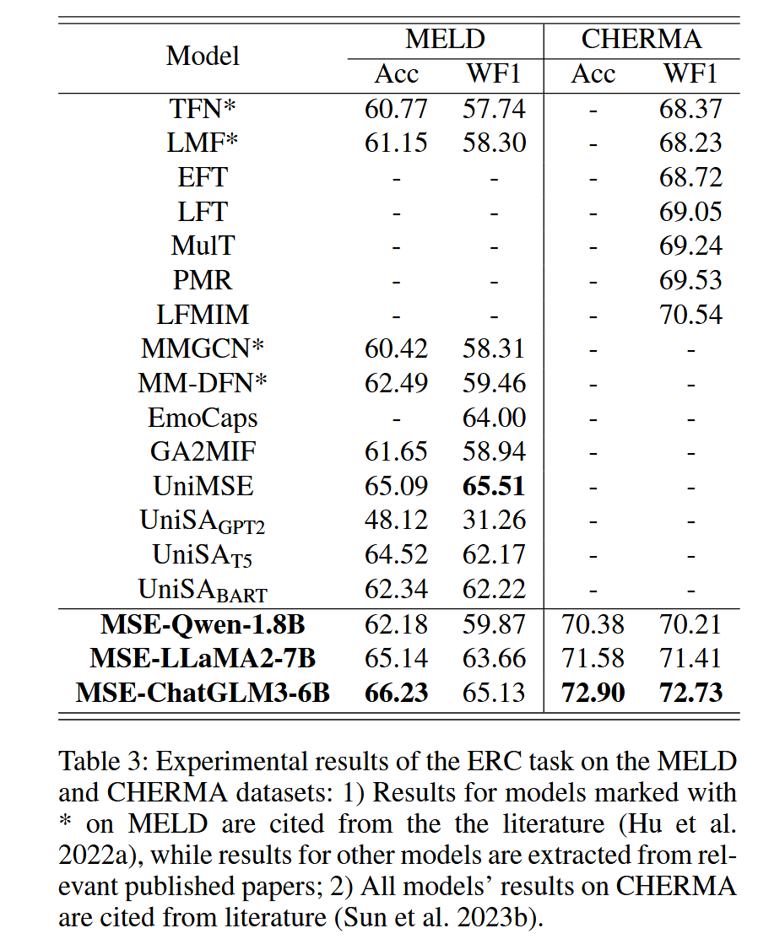
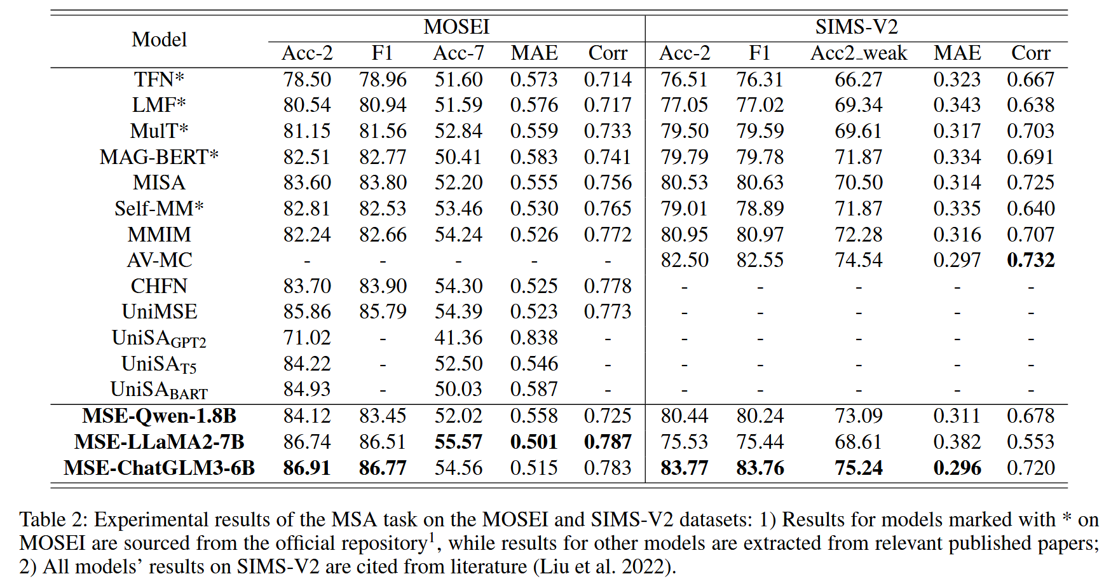
ATAI
Advanced Technique of
Artificial Intelligence
ATAI
ChongqingUniversity _{AdvancedTechniqueof}
of Technology Artificial Intelligence
Chongqing University of Technology
Experiments

Slide 6
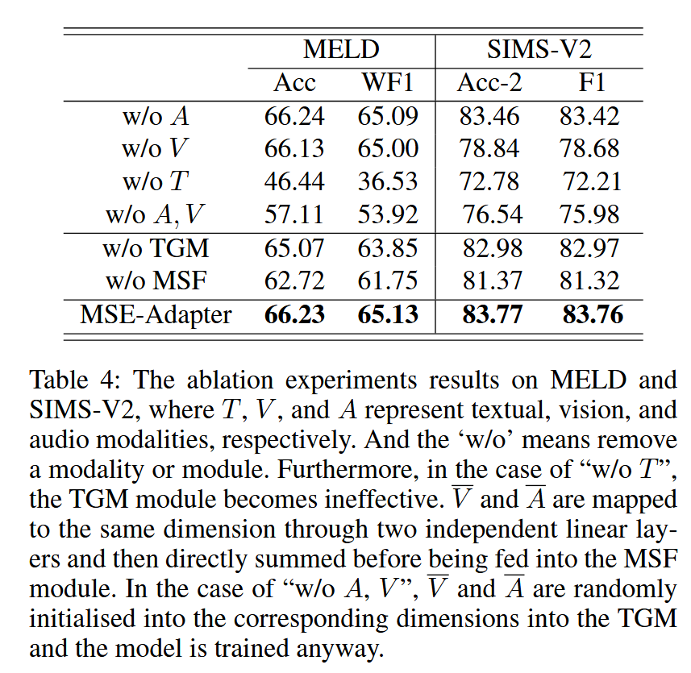
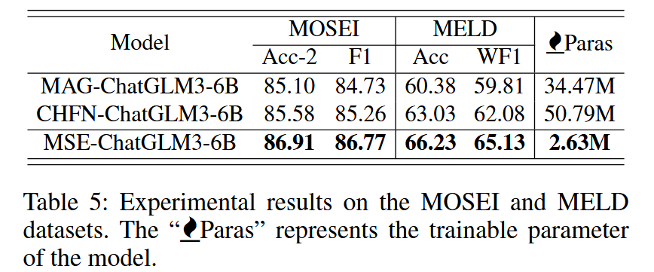
ATAI
Advanced Technique of
Artificial Intelligence
ATAI
ChongqingUniversity _{AdvancedTechniqueof}
of Technology Artificial Intelligence
Chongqing University of Technology
Experiments

Slide 7


ChongqingUniversity of Technology
ATAI
Advanced Technique of
Artificial Intelligence
ATAI
ChongqingUniversity _{AdvancedTechniqueof}
of Technology Artificial Intelligence
Chongqing University of Technology
Thanks!

